Slide 1
MANAGEMENT OF SHOULDER IMPINGEMENT
Dr. Sanket Mungikar
Dept. Of Musculoskeletal Physiotherapy
MGM Institute Of Physiotherapy
Chh.Sambhajinagar

Slide 2
INTRODUCTION
Shoulder impingement is a clinical syndrome in which soft tissues become painfully entrapped in the area of the shoulder joint.
Shoulder impingement syndrome is a syndrome involving tendonitis (inflammation of tendons) of the rotator cuff muscles as they pass through the subacromial space, the passage beneath the acromion.
It is particularly associated with tendonitis of the supraspinatus muscle.
Of all the shoulder disorders, shoulder impingement syndrome (SIS) is the most commonly reported, accounting for 44–65% of all shoulder pain complaints.

Slide 3
Shoulder impingement syndrome can be described according to either the location of the impingement, characterized as external or internal and/or the underlying cause of the impingement, referred to as primary or secondary impingement.
External, or subacromial impingement, results from a mechanical or physical encroachment of the soft tissue located within the subacromial space.
Internal impingement results when the tendons of the rotator cuff (supraspinatus and infraspinatus tendons) encroach between the humeral head and glenoid rim.

Slide 4
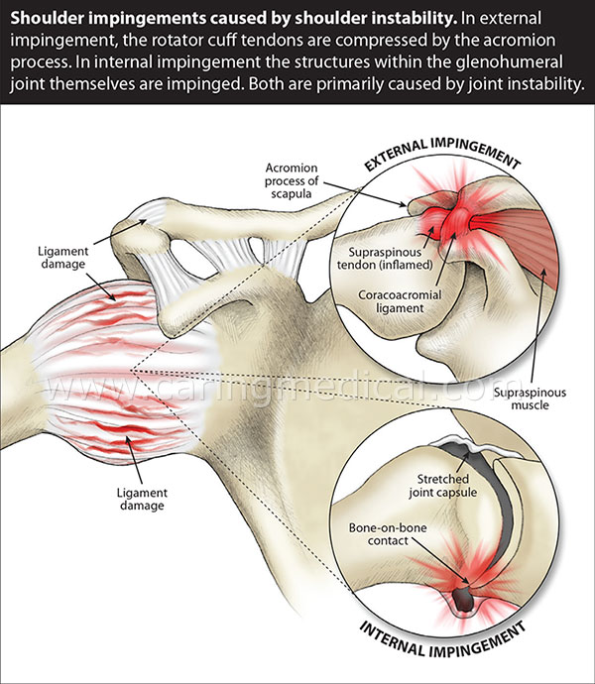

Slide 5
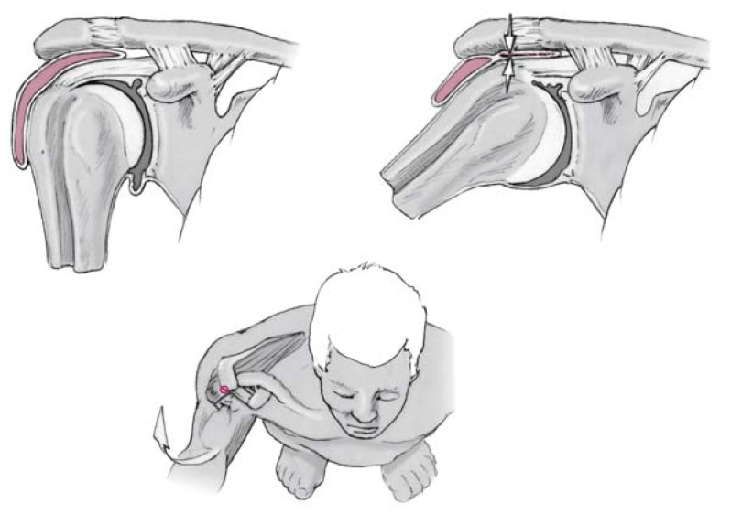
Anatomical overview of the shoulder (left, above), showing the mechanism of subacromial impingement with painful entrapment of soft tissues (arrows, right, above) on elevation of the arm, due to pathological contact of the humeral head with the roof of the shoulder joint, particularly the anterolateral portion of the acromion (below).

Slide 6
In primary impingement, there is a structural narrowing of the subacromial space.
Secondary shoulder impingement syndrome is characterized by normal anatomy at rest and onset of impingement during shoulder motion, likely secondary to rotator cuff weakness, permitting uncontrolled cranial translation of the humeral head.
Another potential cause of secondary impingement syndrome is a weakness of the trapezius and serratus anterior muscles, limiting the external rotation and rise of the scapula with the abduction of the upper extremity, further narrowing the subacromial space.

Slide 7
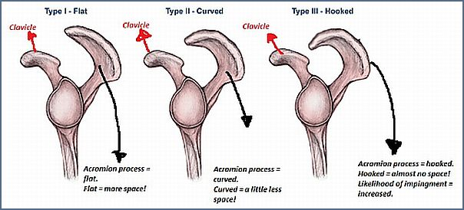

Slide 10
FACTORS RELATED TO PATHOLOGIC CONDITION
Extrinsic factors:
Scapular Muscle Imbalances
Scapular Postural Changes and Altered Kinematics
Rotator Cuff Muscle Imbalance
Intrinsic Factors:
Degeneration
Anatomic Anomalies

Slide 11
SIGNS AND SYMPTOMS
The most common symptoms in impingement syndrome are pain, weakness and a loss of movement at the affected shoulder.
The pain is often worsened by shoulder overhead movement and may occur at night, especially when lying on the affected shoulder.
The pain has been described as dull rather than sharp, and lasts for long periods of time, making it hard to fall asleep.
Other symptoms can include a grinding or popping sensation during movement of the shoulder.
The range of motion at the shoulder may be limited by pain. A painful arc of movement may be present during forward elevation of the arm from 60° to 120°.
Passive movement at the shoulder will appear painful when a downward force is applied at the acromion but the pain will ease once the force is removed.

Slide 12
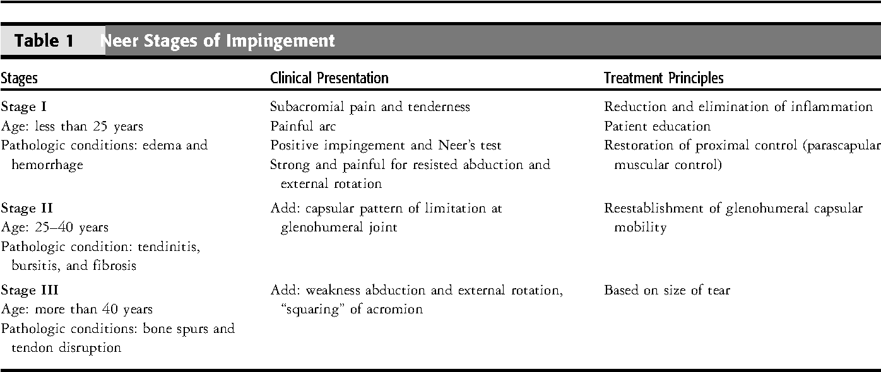

Slide 13
STAGES OF PATHOLOGY
Stage I Impingement
characterized by edema and hemorrhage (inflammation) of the rotator cuff and suprahumeral tissue.
Less than 25 years of age
precipitating factor is overuse of the shoulder.
The clinical symptoms include pain along the anterior and lateral aspect of the shoulder.
The pain described as a deep, dull ache, with sharp subacromial pain during elevation of the limb.

Slide 14
has full AROM and PROM, a painful arc (pain between 60 to 90 degres and 120 degres of elevation of the limb), and an abnormal impingement sign.
Muscle strength is usually normal for the abductors and external rotators of the glenohumeral joint, but muscles can be painful and weak in an acute state.
Palpation elicits subacromial tenderness, usually along the greater tubercle and bicipital groove.
Muscle spasms are often present along the ipsilateral upper trapezius, levator scapulae, and subscapularis muscles. Many of these patients exhibit scapular postural changes including excessive scapular downward rotation and anterior tilting.

Slide 15
Stage II Impingement
characterized by fibrosis of the glenohumeral capsule and subacromial bursa and tendinitis of the involved tendons.
The condition is normally seen in patients between 20 and 40 years old.
The clinical presentation can be similar to that of stage I, except the patient has loss of AROM and PROM because of the capsular fibrosis.
The loss of ROM normally appears in the capsular pattern, as a significant loss of external rotation and abduction, with less loss of internal rotation.

Slide 16
Stage III Impingement
Stage III impingement is the most difficult to treat conservatively and is characterized by disruption of the rotator cuff tendons.
The patient is normally more than 40 years old. Clinically, muscle testing yields weakness, usually for external rotation and abduction.
Visual observation indicates a “squaring” of the acromion, a finding that indicates atrophy of both the rotator cuff and deltoid muscles.
Patients with significant tendon disruption have a positive “drop-arm” or supraspinatus test result

Slide 17
TREATMENT OF IMPINGEMENT REHABILITATION PROTOCOL
The rehabilitation program for the treatment of shoulder impingement is a multiphased approach focused on a return to prior level of function via a systematic process. This treatment program consists of four phases that are a gradual progression of exercises.
The effectiveness of the treatment program is based on the identification of the underlying causative factor or factors and the individualized program designed to address this condition.

Slide 18
PHASE 1: Maximal protection: acute phase
Goals
Relieve pain and inflammation
Normalize range of motion
Reestablish muscular balance
Improve posture
Patient education and
avoidance of aggravating activities

Slide 19
Treatment:
Patient education
Educate patient regarding activity level, activities
Pathology and avoidance of overhead activity, reaching, and lifting activity
Correct seating posture
Seated posture with shoulder retraction, scapular ER
Consider postural shirt for patients with poor posture

Slide 20
Range of motion exercises:
L-bar
Flexion
Elevation in scapular plane
External and internal rotation in scapular plane at 45° abduction
Progress to 90° abduction
Horizontal abduction/adduction
Pendulum exercises
Active-assisted range of motion: limited symptom-free available range of motion
Rope and pulley
Flexion

Slide 21
Joint mobilizations
Inferior and posterior glides to the GH joint
In the early phases of treatment, grade 1 and 2 mobilizations can be performed to neuromodulate pain.
Modalities
Cryotherapy
Once the acute inflammatory stage has abated, the clinician may implement the use of moist heat, warm whirlpool, and/or ultrasound to prepare the soft tissue for range of motion and mobilizations to improve extensibility of the capsule and musculotendinous tissues.

Slide 22
Strengthening exercises
Flex/ext strengthening
External rotation strengthening
If painful, isometrics (ER, internal rotation, Abd)
Scapular strengthening
Retractors
Depressors
Protractors
Postural exercises
Strengthen scapular muscles (depressors, retractors, and protractors)
Stretch pectoralis minor (corner stretch)
Wall circles

Slide 23
Guideline for progression:
Decreased pain and/or symptoms
Normal range of motion
Elimination of painful arc
Muscular balance

Slide 24
PHASE 2: Intermediate phase
Goals
Reestablish no painful range of motion
Normalize arthrokinematics of shoulder complex
Normalize muscular strength
Maintain reduced inflammation and pain
Increase activities with involved arm

Slide 25
Range of motion
L-Bar
Flexion
External rotation at 90° of abduction
Internal rotation at 90° of abduction
Horizontal abduction/adduction at 90°
Rope and pulley
Flexion
Joint mobilization
Continue joint mobilization techniques to the tight aspect of the shoulder (especially inferior)
Initiate self-capsular stretching
Inferior, anterior, and posterior glides
Combined glides as required

Slide 26
Modalities (as needed)
Cryotherapy
Ultrasound/phonophoresis
Iontophoresis
Postural exercises
Continue with stretching of pectoralis minor and strengthening scapular muscles
Strengthening exercises
Progress to complete shoulder exercise program
Emphasize rotator cuff and scapular muscular training
ER tubing
Sidelying ER
Shoulder abduction
Prone horizontal abduction

Slide 27
Prone shoulder extension
Prone rowing
Biceps/triceps
Lower trapezius muscular strengthening
Scapular neuromuscular exercises
Functional activities
Gradually allow an increase in functional activities
No prolonged overhead activities
No lifting activities overhead

Slide 28
PHASE 3: Advanced strengthening phase
Goals
Improve muscular strength and endurance
Maintain flexibility and range of motion
Maintain postural correction
Gradual increase in functional activity level

Slide 29
Flexibility and stretching
Continue all stretching and range-of-motion exercises
L-Bar: ER/internal rotation at 90° abduction
Continue capsular stretch
Maintain/increase posterior/inferior flexibility
Strengthening exercises
Establish patient on the fundamental shoulder exercises
Tubing ER/internal rotation
Lateral raises to 90° dumbbell
Full can dumbbell to 90°
Sidelying ER

Slide 30
Prone horizontal abduction
Prone extension
Wall slides
Biceps/triceps
Guideline for progression to phase 4
Full, no painful range of motion
No pain or tenderness
Good strength
Satisfactory clinical examination

Slide 31
PHASE 4: Return to activity phase
Goals
Unrestricted, symptom-free activity

Slide 32
Initiate interval sport program
Throwing
Tennis
Maintenance exercise program
Flexibility exercises
L-Bar
Flexion
External rotation and internal rotation at 90° abduction
Self-capsular stretches
Isotonic exercises
Fundamental shoulder exercises
Perform three times a week

Slide 33
ARTICLES

Slide 34
ELECTROTHERAPY

Slide 35
Comparison of different electrotherapy methods and exercise therapy in shoulder impingement syndrome: A prospective randomized controlled trial
Sevtap Gunay Ucurum, Derya Ozer Kaya, et al
Acta Orthopedic and Traumatology Turcica. July 2018
The aim of this study was to assess and compare the effects of different electrotherapy methods and exercise therapy on pain, function and quality of life in shoulder impingement syndrome.
79 patients with shoulder impingement syndrome were randomly allocated into four groups. Group 1 was given hot pack and exercises, Group 2 was given hot packs, exercises and interferential current, Group 3 was given hot packs, exercises and TENS and Group 4 was given hot packs, exercises and ultrasound 3 times a week for 4 weeks.

Slide 36
Application of ultrasound, interferential current and TENS in addition to exercise therapy in shoulder impingement syndrome treatment had similar improvements in terms of pain, function and physical component of quality of life. However, interferential current treatment showed significantly better outcomes for the mental component of quality of life.26

Slide 37
2. Comparative effectiveness of ultrasonophoresis and iontophoresis in impingement syndrome: a double-blind, randomized, placebo controlled trial
Isabel García, Cristina Lobo, et al
Clinical Rehabilitation, April 2016
The aim of this study is to estimate the effectiveness of ultrasonophoresis and iontophoresis with sodium diclofenac used in addition to an exercise program for patients with impingement syndrome.
The patients were randomly assigned to one of three groups: a) standard treatment (supervised exercises and cryotherapy) along with placebo iontophoresis and placebo ultrasonophoresis; b) standard treatment, iontophoresis, and placebo ultrasonophoresis; and c) standard treatment, ultrasonophoresis, and placebo iontophoresis. All patients received 15 treatment sessions.

Slide 38
In patients with impingement syndrome, a combination of ultrasonophoresis and an exercise program are better than a combination of iontophoresis and the same exercise program or the exercise program alone.

Slide 39
3. Efficacy of low-level laser therapy combined with exercise for subacromial impingement syndrome: A randomised controlled trial
Patrícia Pereira Alfredo, Jan Magnus Bjordal, et al.
Clinical Rehabilitation Dec 2020
The objective of this study is to investigate the effect of low-level laser therapy (LLLT) combined with exercise on shoulder pain and disability in patients with subacromial impingement syndrome (SIS).
Groups I (n = 42), II (n = 42) and III (n = 36) were treated with Low-level laser therapy and exercise, exercise only and Low-level laser therapy only, respectively. Interventions were conducted three times a week for 8 weeks.

Slide 40
Low-level laser therapy combined with exercises reduce pain intensity, improve shoulder function and reduces pain intensity and medication intake over 3 months.

Slide 41
EXERCISES

Slide 42
4. Stretching Exercises for Subacromial Impingement Syndrome: Effects of 6-Week Program on Shoulder Tightness, Pain, and Disability Status
Elif Turgut, Irem Duzgun, and Gul Baltaci
Journal of Sport Rehabilitation March 2018
The aim of this study was to investigate the effects of a stretching program on posterior capsule tightness, pectoralis minor tightness, pain severity, and disability status in SIS.
The 6-week self-stretching program for pectoralis minor, posterior capsule, levator scapula, and latissimus dorsi was performed.
The findings of the study showed that flexibility, pain severity, and disability gains can be achieved with a 6-week stretching exercise training for participants with SIS. Therefore, shoulder girdle stretching exercises should be recommended early in shoulder rehabilitation program.

Slide 44
5. Effect of scapular stabilization exercise program in patients with subacromial impingement syndrome: a systematic review
Hariharasudhan Ravichandran, Balamurugan Janakiraman
Journal of Exercise Rehabilitation June 2020
This systematic review aims to evaluate and summarize the best evidence regarding the role of scapular stabilization interventions in alleviating shoulder dysfunction among subjects with subacromial impingement syndrome.
They found that there was a significant effect on the scapular stabilization exercise program on improving pain and disability among subjects with subacromial impingement syndrome.
This systematic review provides sufficient evidence to suggest that scapular stabilization exercises offers effectiveness in reducing pain and disability among subjects with subacromial impingement syndrome.

Slide 47
6. Effect of supervised physiotherapy versus home exercise program in patients with subacromial impingement syndrome: A systematic review and meta-analysis
Héctor Gutiérrez-Espinoza, Felipe Araya-Quintanilla, et al
Physical Therapy in Sports Jan 2020
The objective of the study is to determine whether supervised physiotherapy is more effective for functional improvement and pain relief than a home exercise program in subjects with subacromial impingement syndrome.
Seven clinical trials included.
Supervised physical therapy and home-based progressive shoulder strengthening and stretching exercises for the rotator cuff and scapular muscles are equally effective in patients with subacromial impingement syndrome treated conservatively.

Slide 48
MANUAL THERAPY

Slide 49
7. Effects of mobilization with movement on pain and range of motion in patients with unilateral shoulder impingement syndrome: a randomized controlled trial
José A Delgado-Gil, Eva Prado-Robles, et al
Journal of Manipulative and Physiological Therapeutics April 2015
The purpose of this study was to compare the immediate effects of mobilization with movement (MWM) to a sham technique in patients with shoulder impingement syndrome.
Forty-two patients were randomized into an MWM group or sham manual contact.
Patients with shoulder impingement syndrome who received 4 sessions of MWM exhibited significantly better outcomes for pain during shoulder flexion, pain-free range of shoulder flexion, maximal shoulder flexion, and maximal external rotation than those patients who were in the sham group.

Slide 51
TAPING

Slide 52
8. Does taping in addition to physiotherapy improve the outcomes in subacromial impingement syndrome? A systematic review
Ismail Saracoglu, Yusuf Emuk & Ferruh Taspinar
Physiotherapy Theory and Practice April 2018
The aim of this review was to determine whether any taping technique in addition to physiotherapy care is more effective than physiotherapy care alone in patients with shoulder impingement syndrome.
3 RCT’S and 1 controlled trial were included.
They concluded that Clinical taping in addition to physiotherapy interventions (e.g. exercise, electrotherapy, and manual therapy) might be an optional modality for managing patients with shoulder impingement syndrome, especially for the initial stage of the treatment.

Slide 53
REFERENCES
Julie A. Creech; Sabrina Silver. Shoulder Impingement Syndrome. NCBI Bookshelf. May 2020.
Escamilla RF, Hooks TR, et al. Optimal management of shoulder impingement syndrome. Journal of sports med. 2014; 5: 13–24.
Robert A. donatelli (2012). Physical therapy of shoulder. 5th edition. Elsevier.
S. Brent Brotzman, Robert C. Manske. Clinical OrthopedIc Rehabilitation: An Evidence-based Approach . 3rd edition. Elsevier.
David J. Magee, James E. Zachazewski, et al. (2016) Pathology And Intervention In Musculoskeletal Rehabilitation. 2nd edition. Elsevier

Slide 54
Garving C., Jakob S., et al. Impingement Syndrome of the Shoulder. Dtsch Arztebl Int. 2017 Nov 10;114(45):765-776.
Beirer M, Imhoff AB, Braun S. Impingement syndromes of the shoulder. Orthopade. 2017 Apr;46(4):373-386.
Subacromial Pain Syndrome. (2020, October 17). Physiopedia, . Retrieved 21:04, December 26, 2020 from https://www.physio-pedia.com/index.php?title=Subacromial_Pain_Syndrome&oldid=254756
Internal Impingement of the Shoulder. (2020, October 15). Physiopedia, . Retrieved 21:05, December 26, 2020 from https://www.physio-pedia.com/index.php?title=Internal_Impingement_of_the_Shoulder&oldid=254525.

